Slide 1
AWS Technical Essentials Project – Server Monitoring
By
Nilesh Shardul

Slide 2
DESCRIPTION
Heaven Classics successfully creates an EC2 Server Instance for Windows 2012 Server. After launching the instance on the server, the next step was to monitor the operations.
Monitoring is important to keep an eye on the performance of an EC2 instance. It helps gather data from all parts and is useful for debugging failure.
The monitoring team at Heaven Classics started monitoring activities using the CloudWatch Service in the AWS Management Console. The Heaven Classics support team were required to meet the following objectives:
Check and observe the CPU utilization graph for the EC2 instance
Create and configure a CloudWatch alarm that sends an email notification to HCMonitor@HeavenClassics.com if the CPU utilization goes below the threshold of 3%, consecutively three times for five minutes
Create an IAM group named Administrator Group and attach the full administrator access policy to the group
Create a user for an employee of the company who requires administrator access to the company's AWS account, and then add the user to the Administrator Group.

Slide 3
Objective 1 : Check and observe the CPU utilization graph for the EC2 instance
First create the EC2 instance for Windows 2012 Server and configure the monitoring as per the given steps below

Slide 4
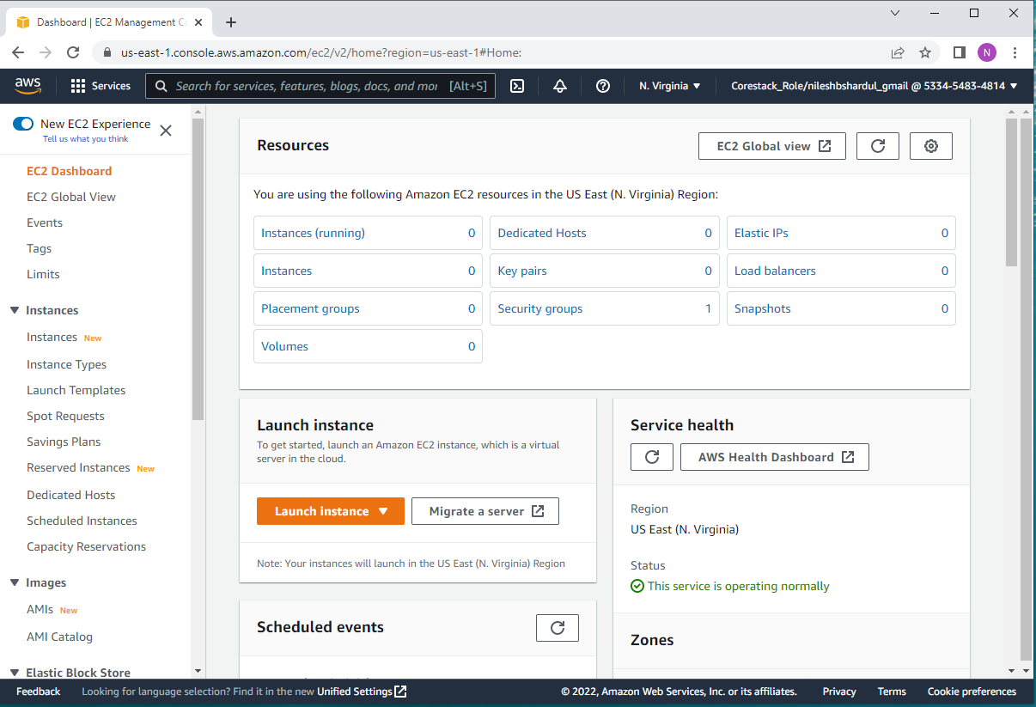
Step 1: Go to EC2 Service and click on Launch Instance

Slide 5
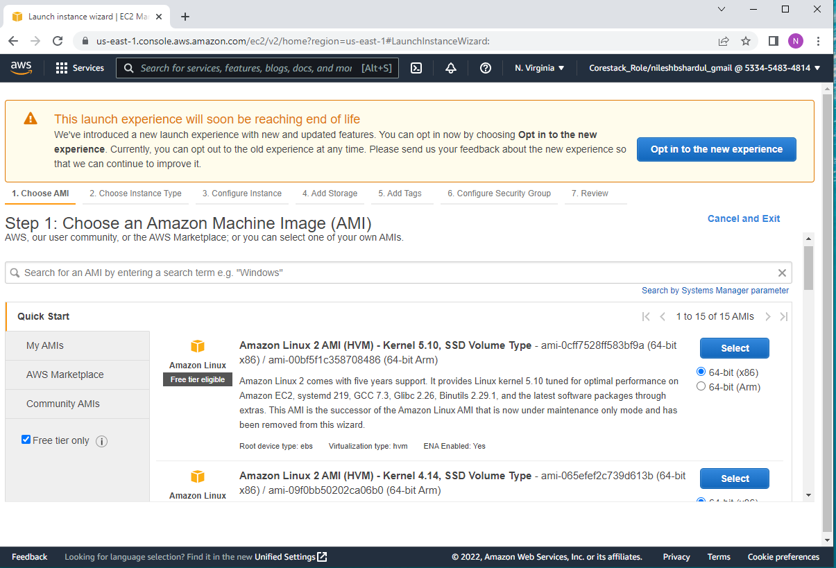
Step 2: Select Amazon Linux 2 AMI as shown below

Slide 6
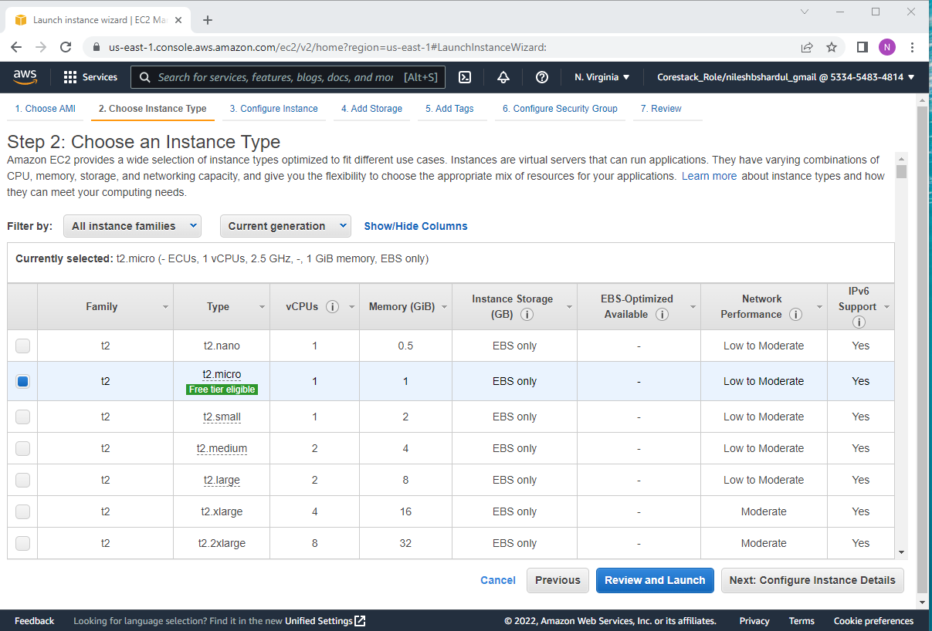
Step 3: Select instance type as t2.micro and click on Review and Launch

Slide 7
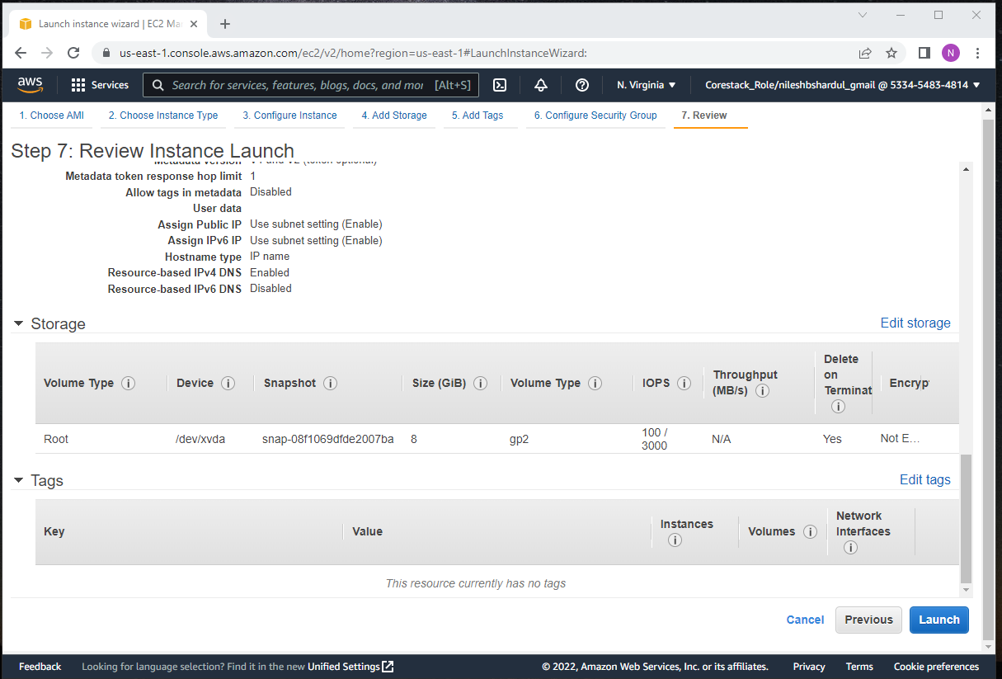
Step 4: Keep default values for VPC, Subnet, Security Group, Storage etc. and click on Edit tags

Slide 8
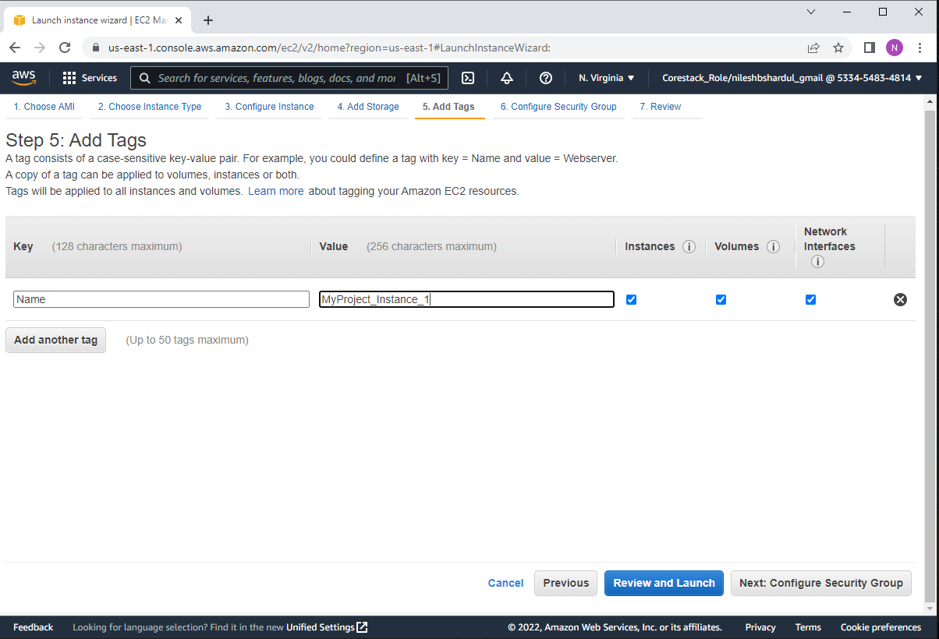
Step 5: Give instance name e.g., MyProject_instance_1 and click on Review and Launch button

Slide 9
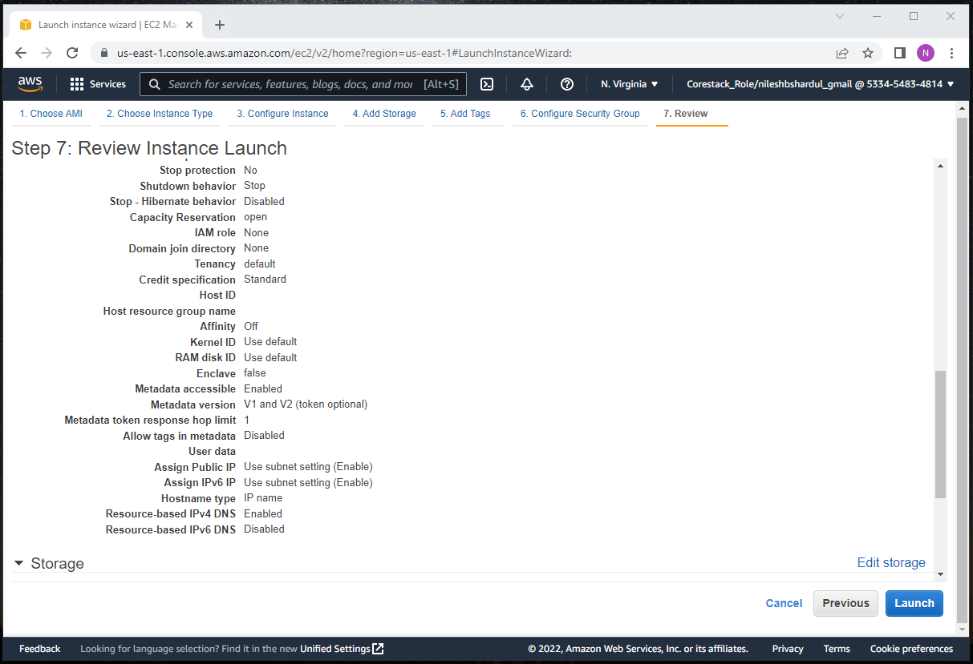
Step 6: Click on Launch button

Slide 10
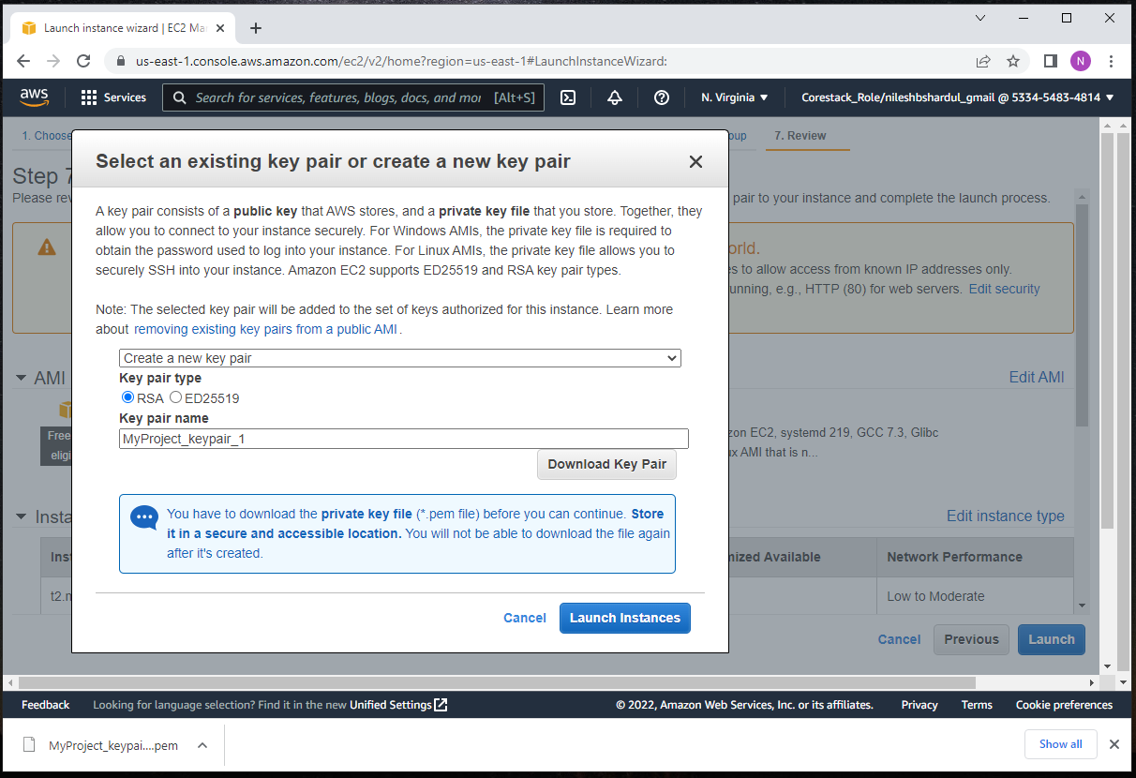
Step 7: Create new keypair giving some name e.g., MyProject_keypair_1, download file on your machine and click on Launch instances button

Slide 11
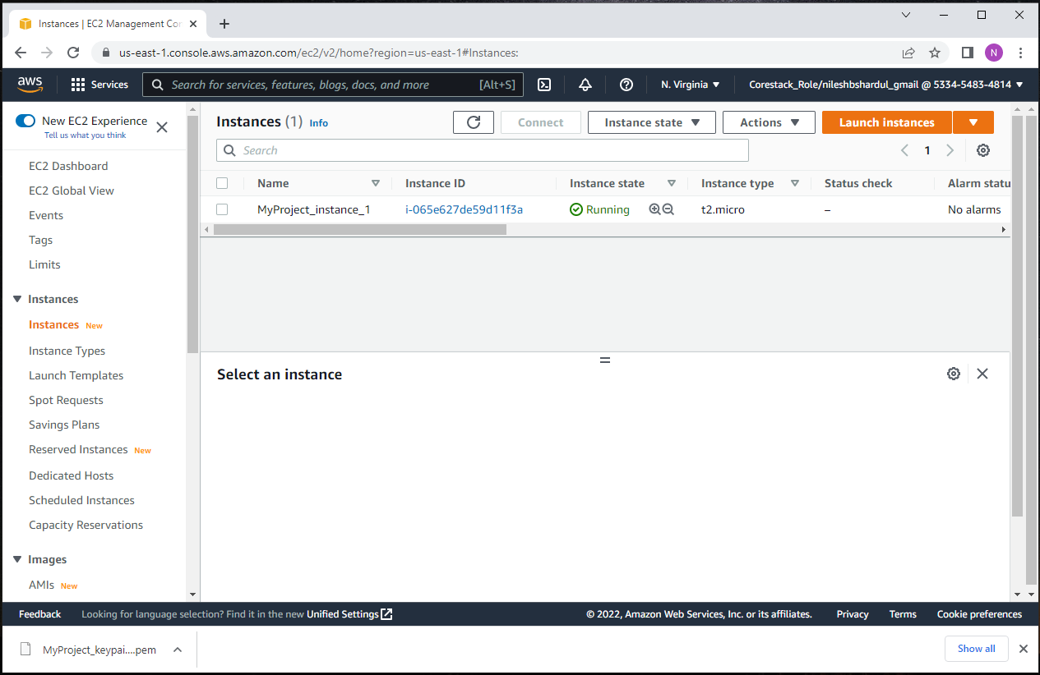
Step 8: Check if new instance is running

Slide 12
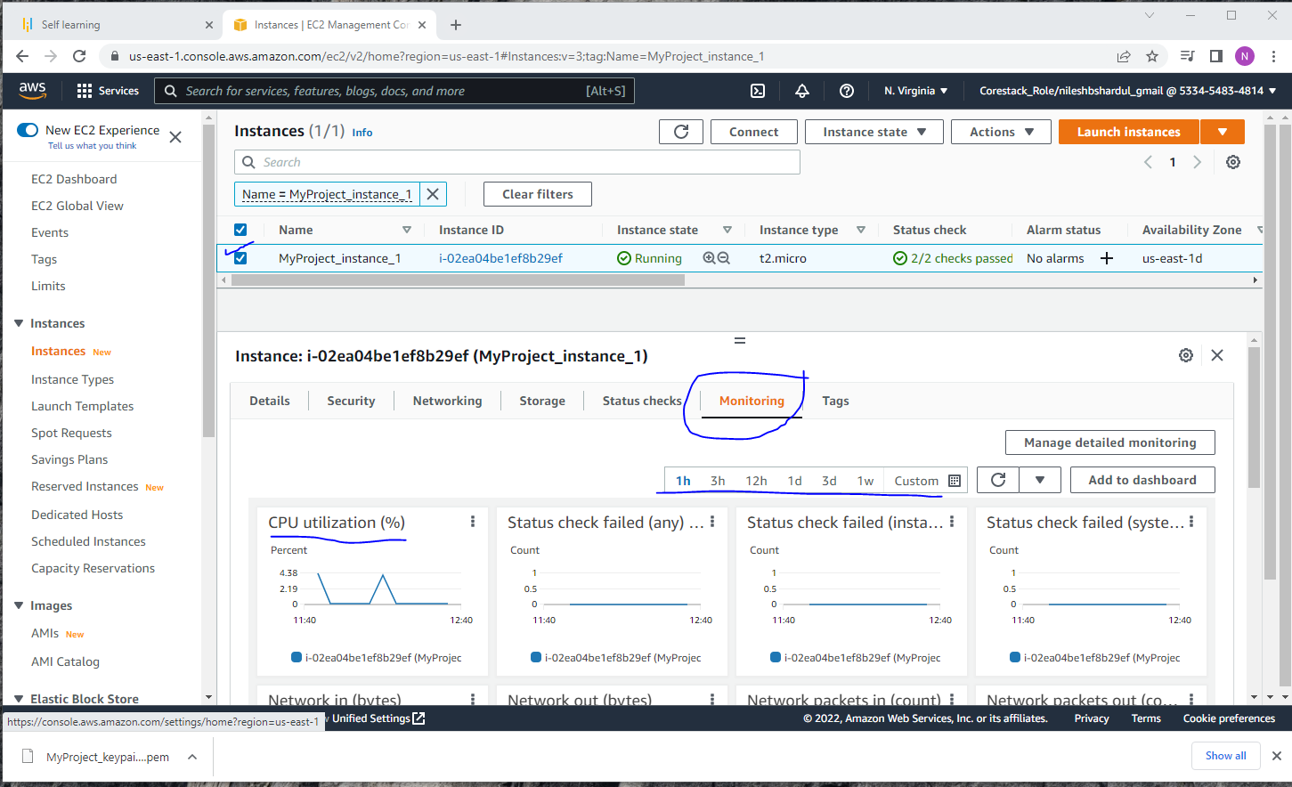
Step 9: Select the EC2 instance and click on Monitoring tab to see CPU utilization(%) from CloudWatch. You can select the duration in the Graph

Slide 13
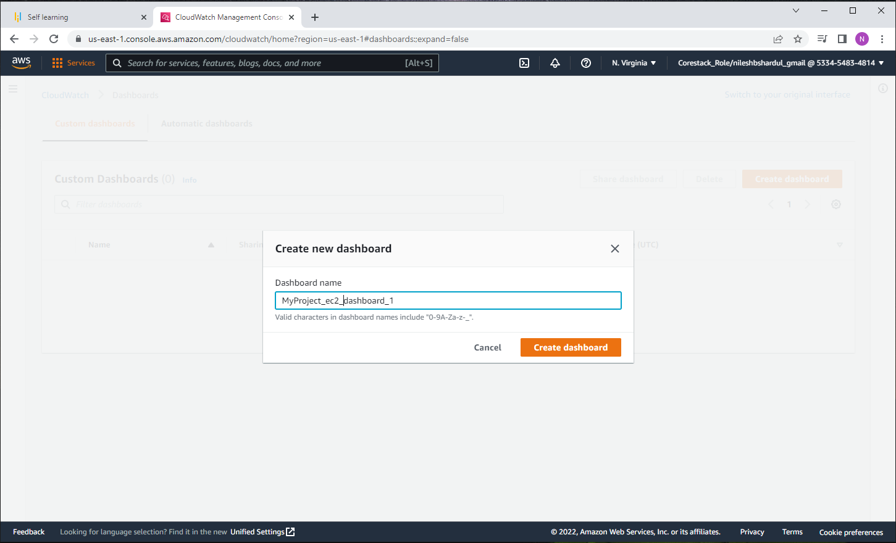
Step 10 :Type the name of dashboard e.g., MyProject_ec2_dashboard_1

Slide 14
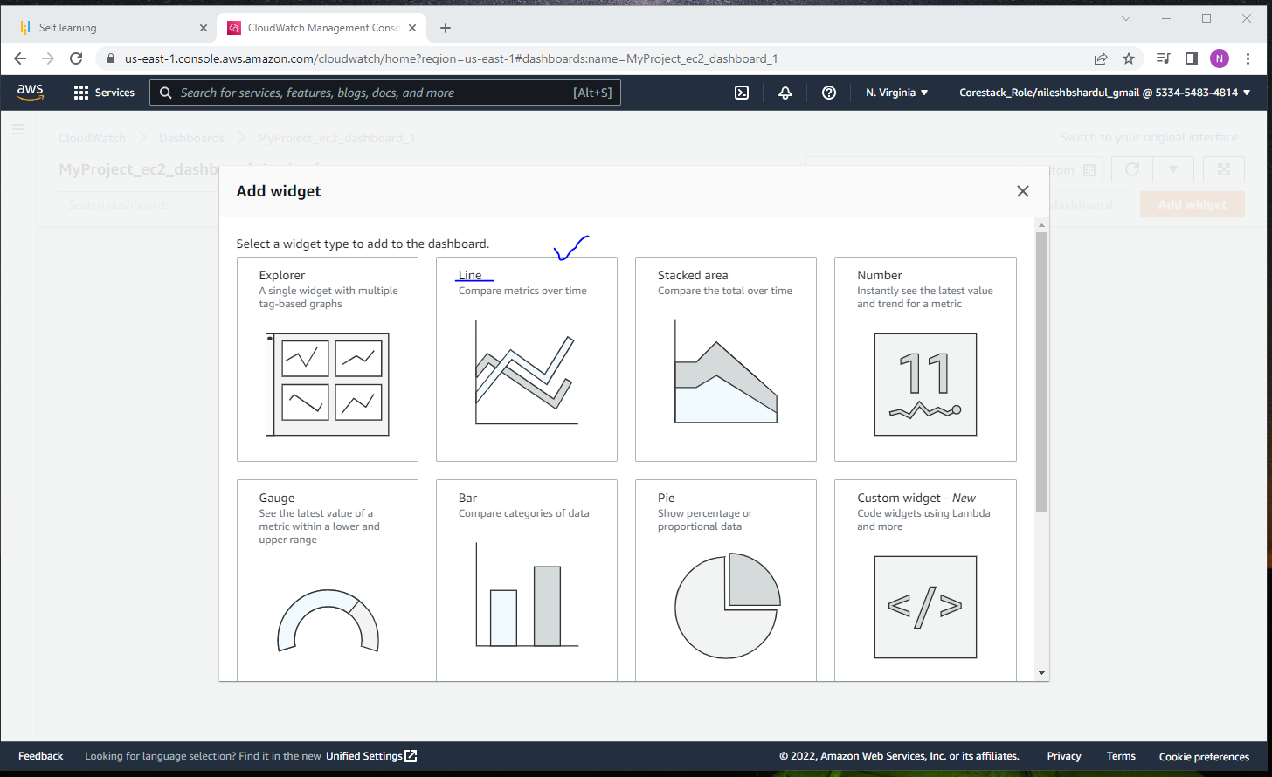
Step 11: Select Graph type as Line Graph as shown below

Slide 15
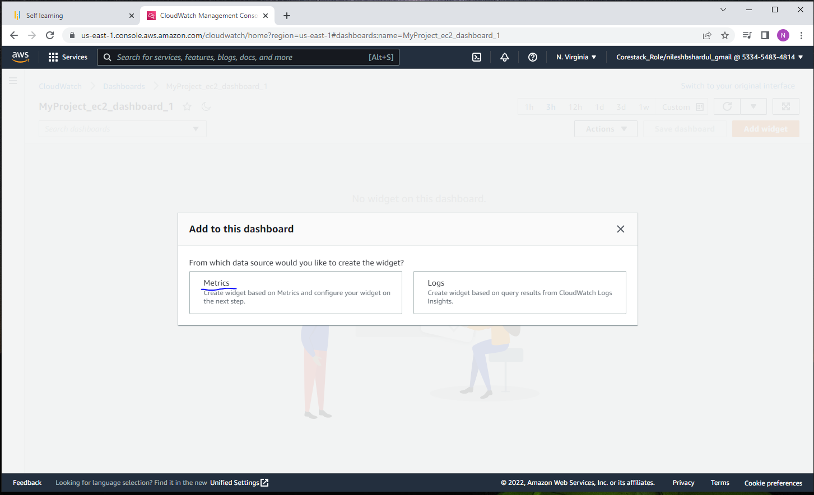
Step 12: Click on Metrics as shown below

Slide 16
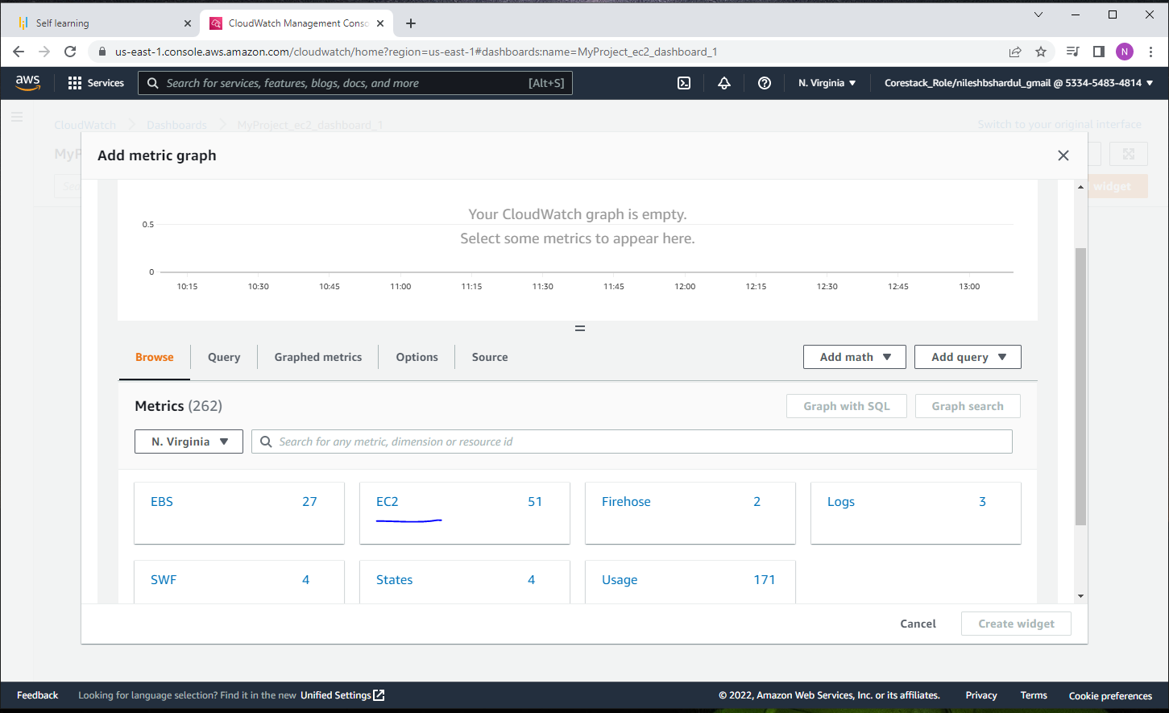
Step 13: Select EC2 service as shown below

Slide 17
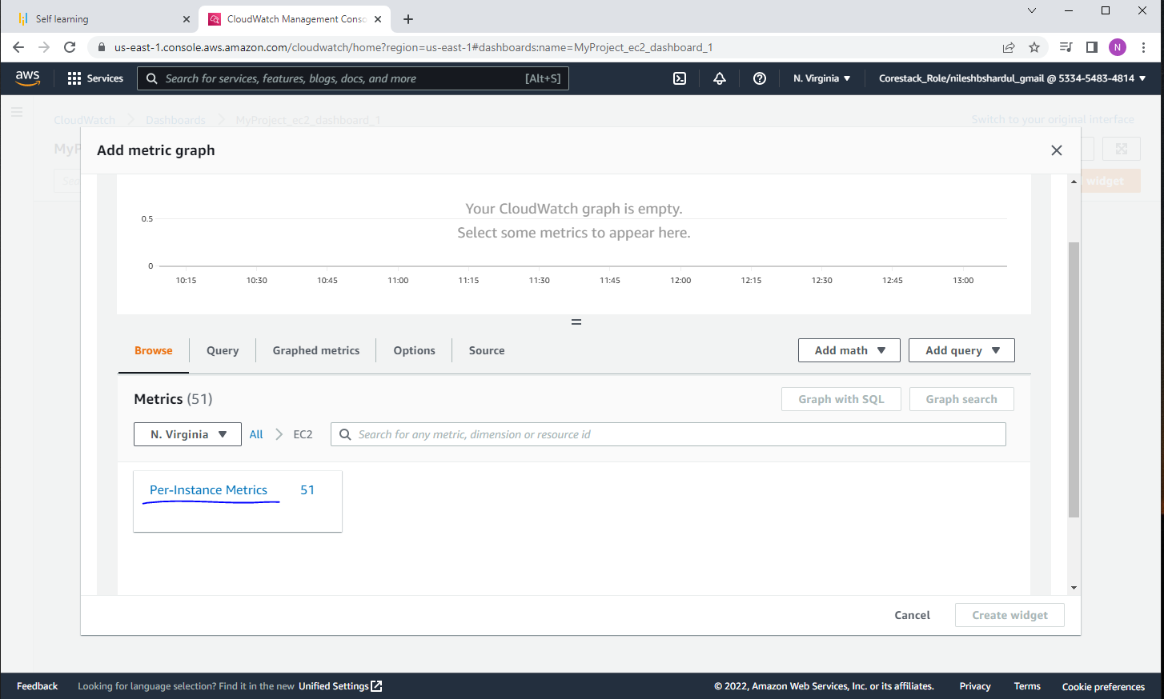
Step 14: Select per-instance metrics as shown below

Slide 18
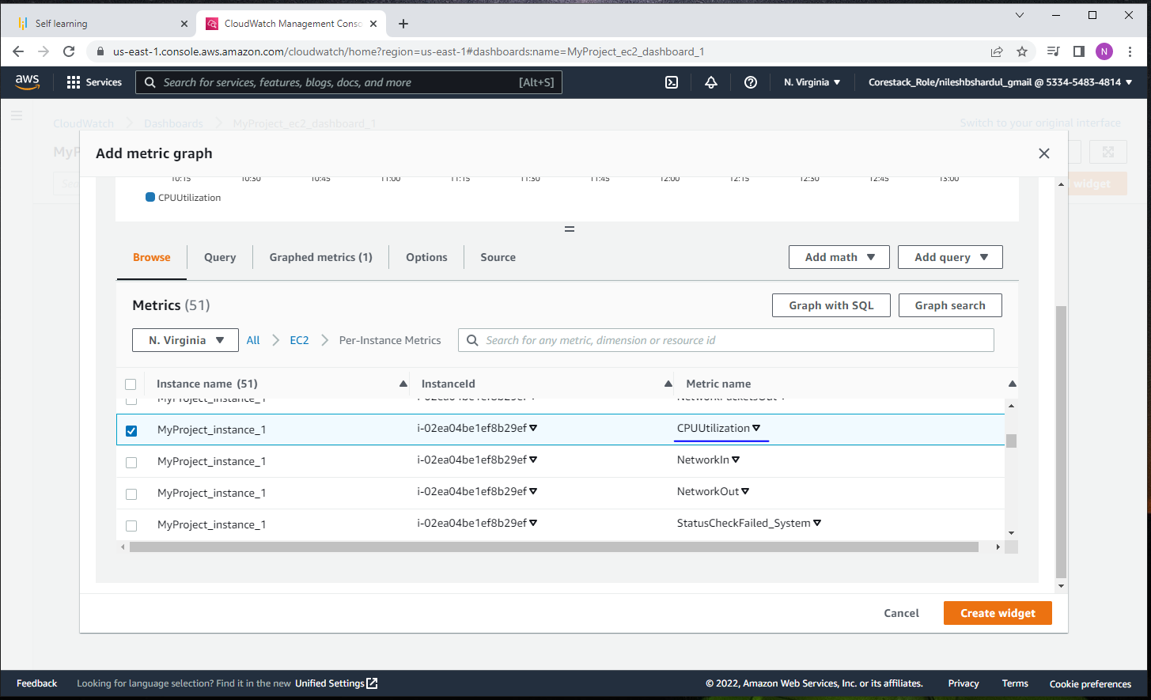
Step 15: Select Metric CPUUtilization and click on Create widget button

Slide 19
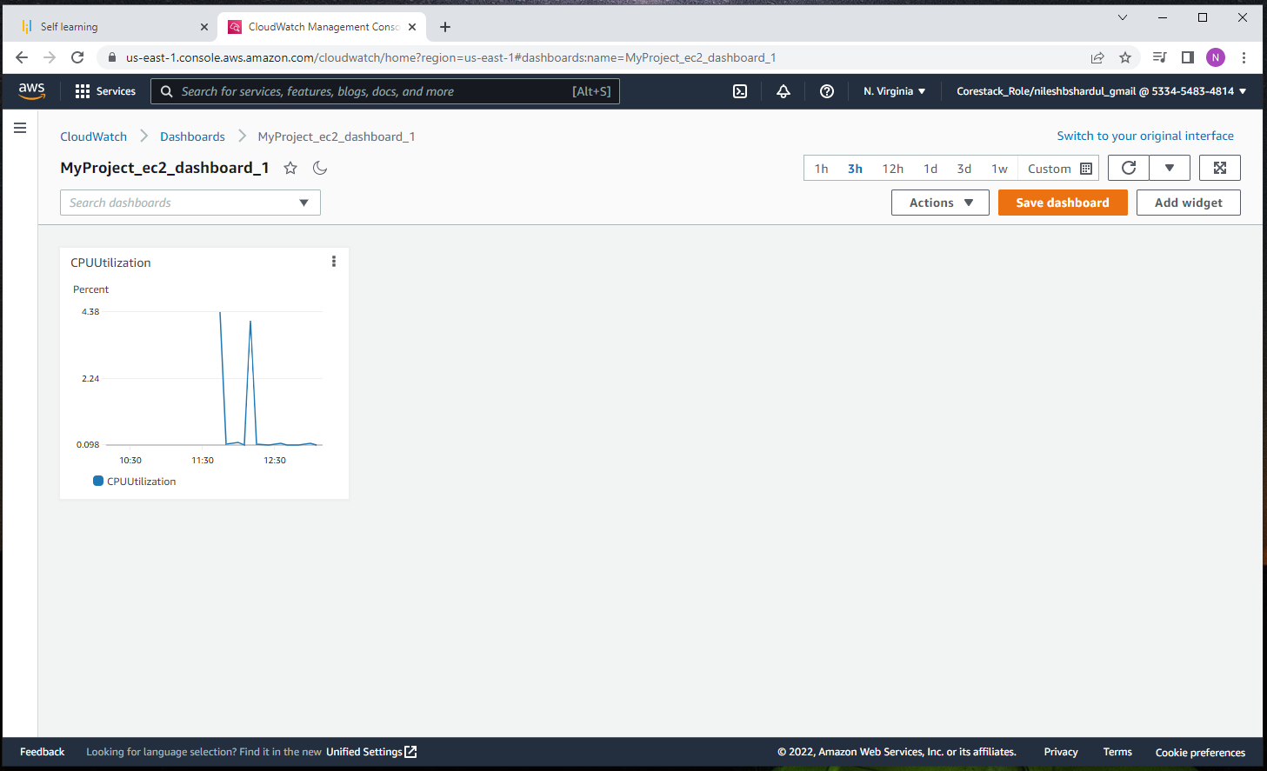
Step 16: After that you can see the Dashboard created ( in this project MyProject_ec2_dashboard_1 )

Slide 20
Objective 2 : Create and configure a CloudWatch alarm that sends an email notification to HCMonitor@HeavenClassics.com if the CPU utilization goes below the threshold of 3%, consecutively three times for five minutes
Follow the below steps to create and configure alarm with the given email

Slide 21
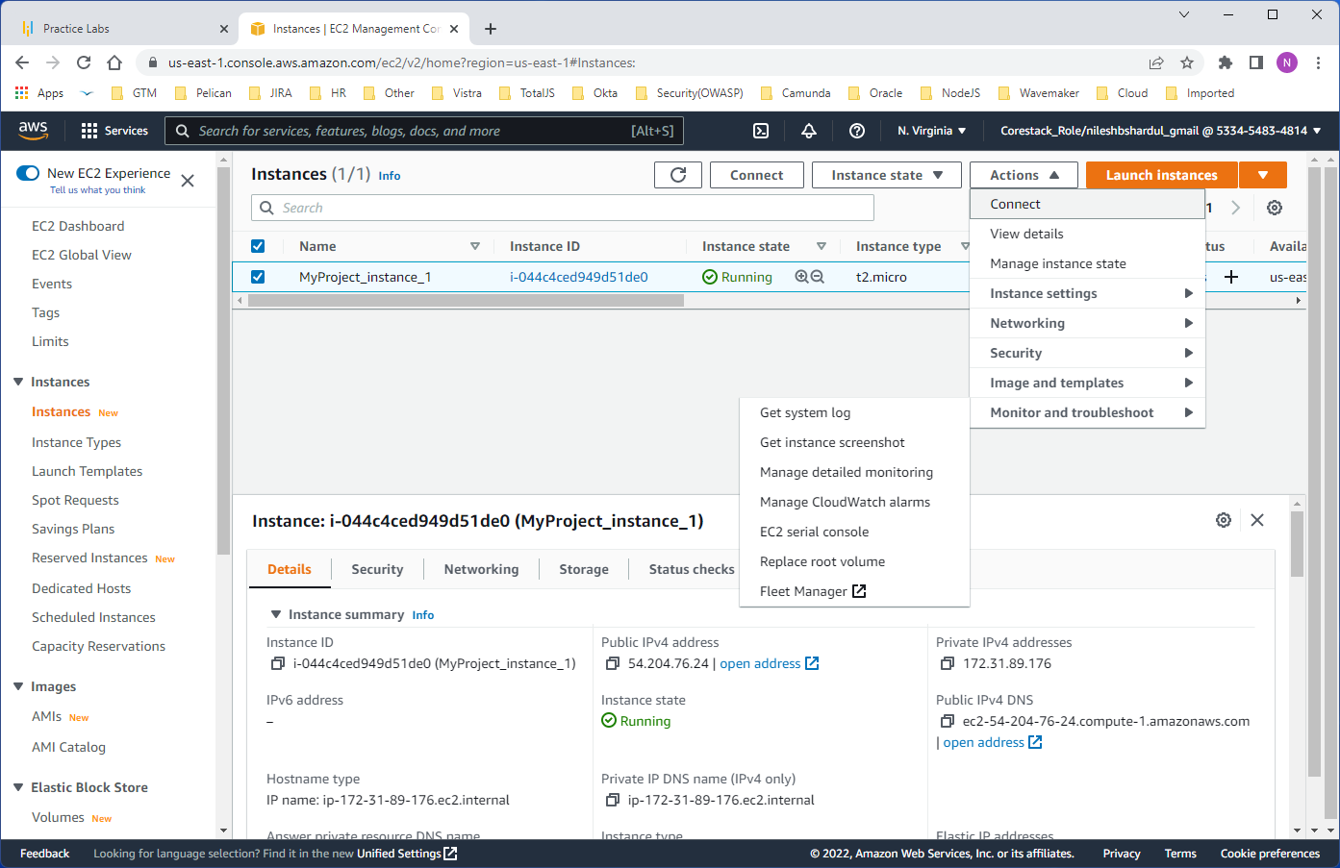
Step 1: Select EC2 instance, go to Actions->Monitor and troubleshoot->Manage CloudWatch alarms

Slide 22
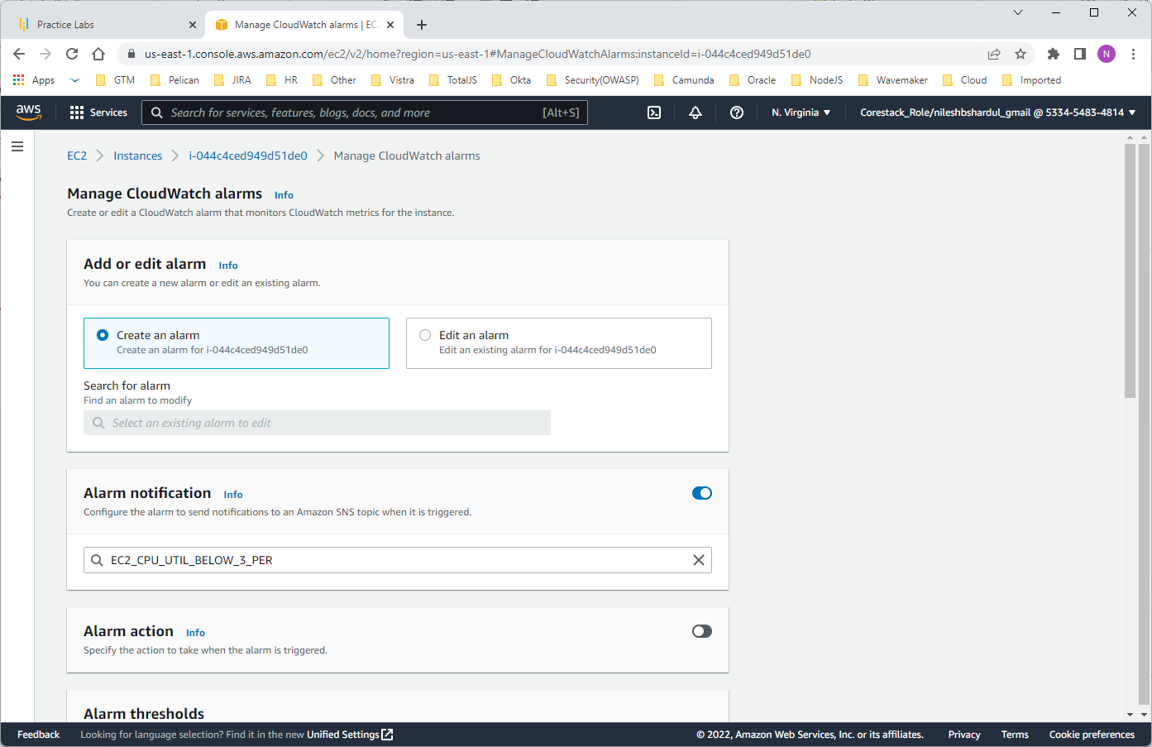
Step 2: Select Create an alarm and write new topic name e.g., EC2_CPU_UTIL_BELOW_3_PER and configure the email id HCMonitor@HeavenClassics.com later as given in below steps (Step 6)
Note : you can write existing topic name here with email id HCMonitor@HeavenClassics.com configured

Slide 23
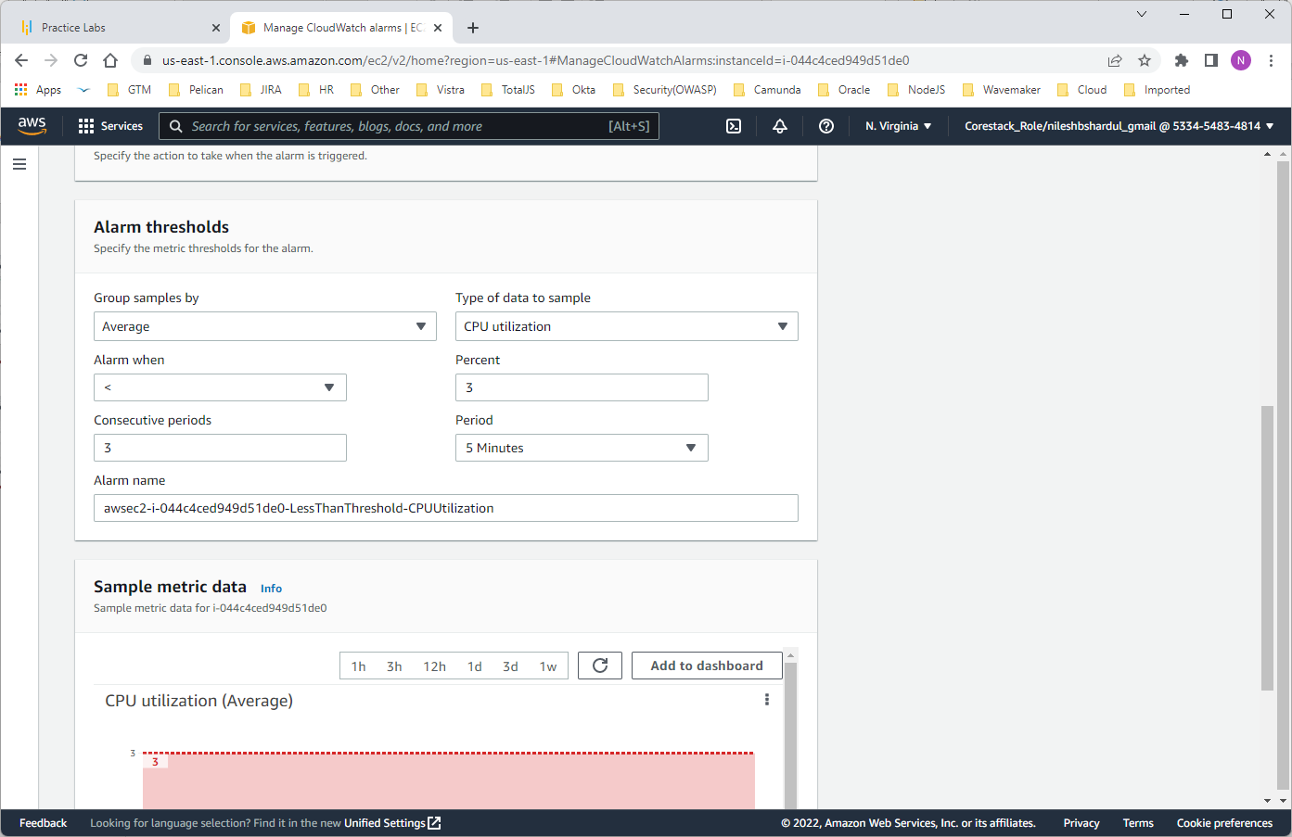
Step 3: Set Alarm thresholds i.e., if CPU Utilization goes below the threshold of 3%, consecutively 3 times for 5 minutes as shown below

Slide 24
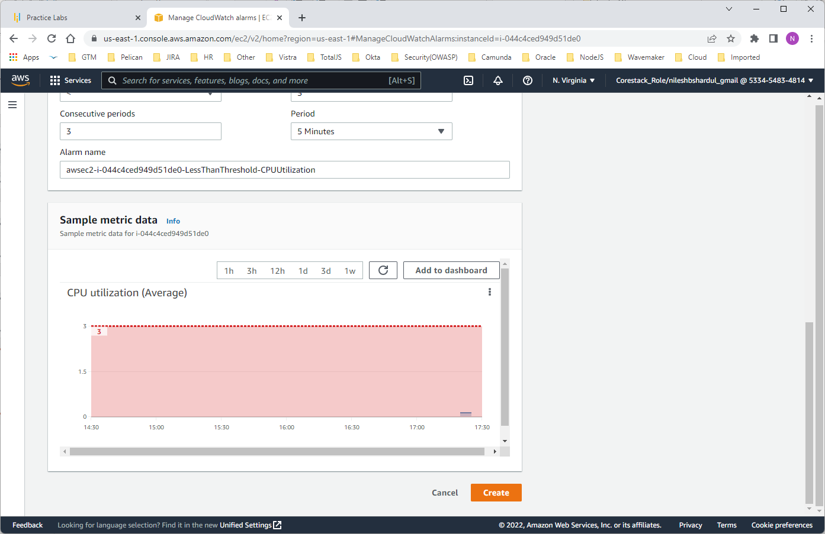
Step 4: Click on Create button

Slide 25
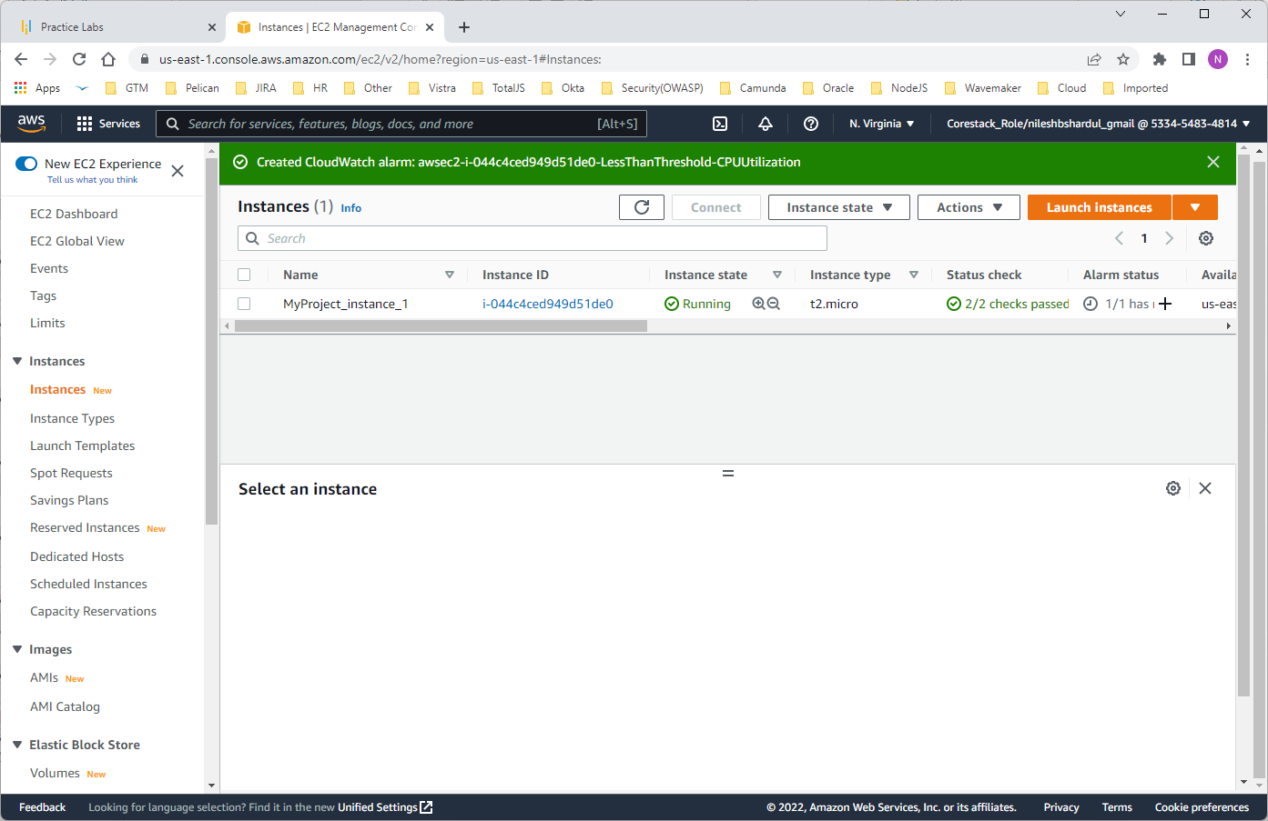
Step 5: New alarm is created for the selected instance

Slide 26
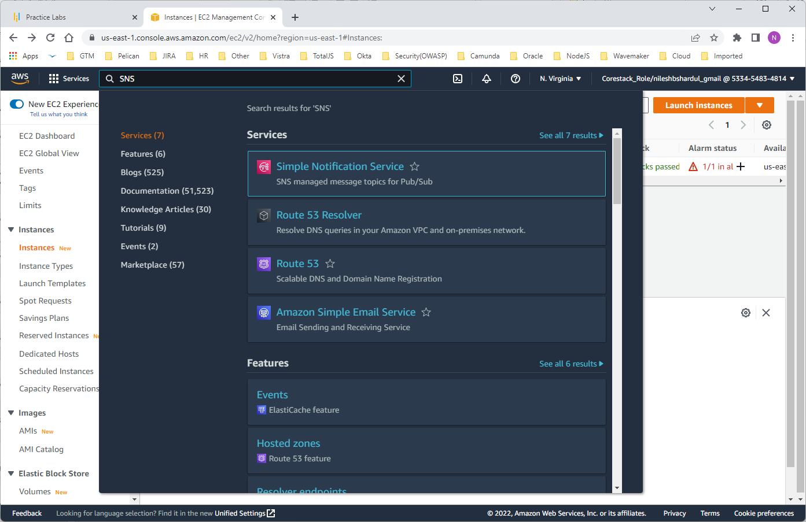
Step 6: Now as discussed in above slides if you have created new SNS topic you need to configure given email id (HCMonitor@HeavenClassics.com). For the same, go to SNS service

Slide 27
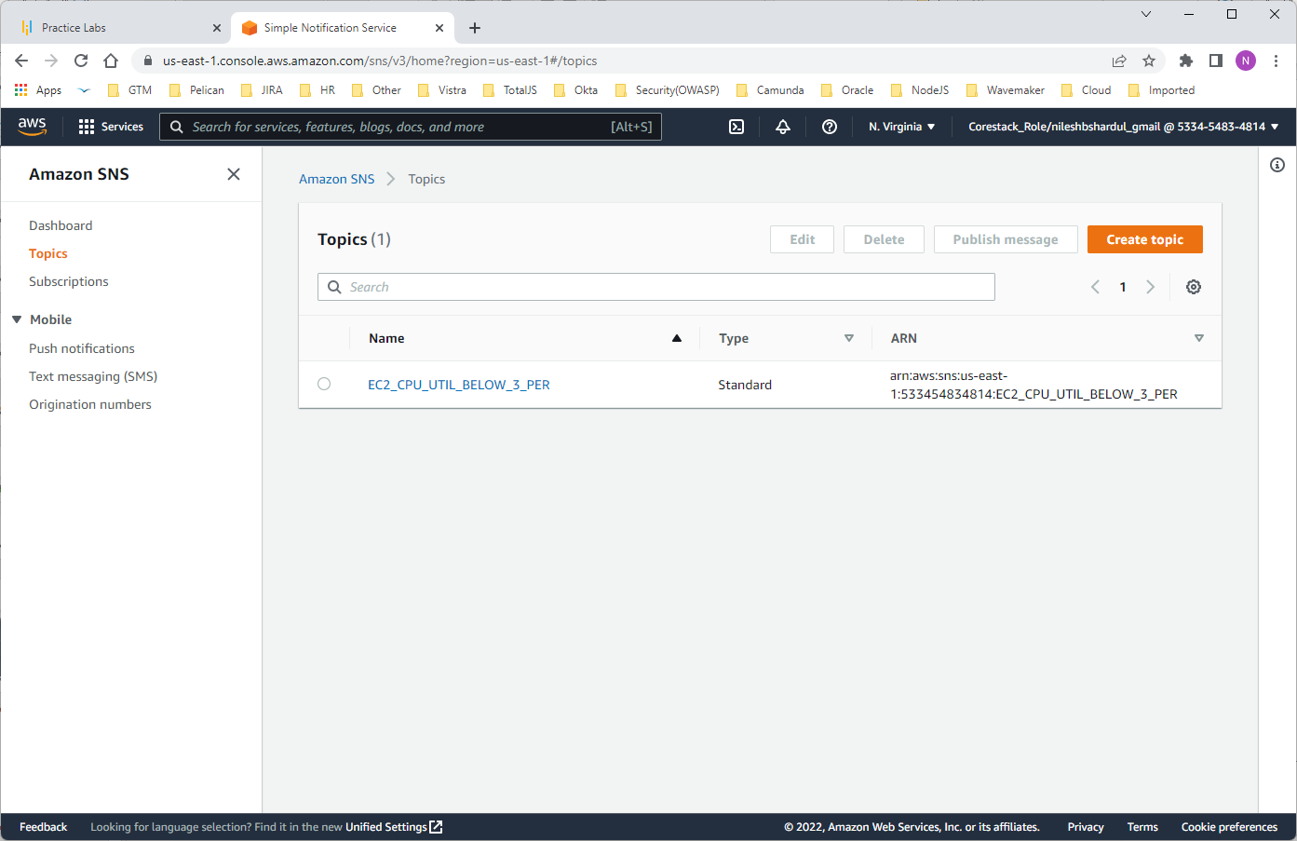
Step 7: Select the topic you have created. We have created topic name EC2_CPU_UTIL_BELOW_3_PER in earlier steps

Slide 28
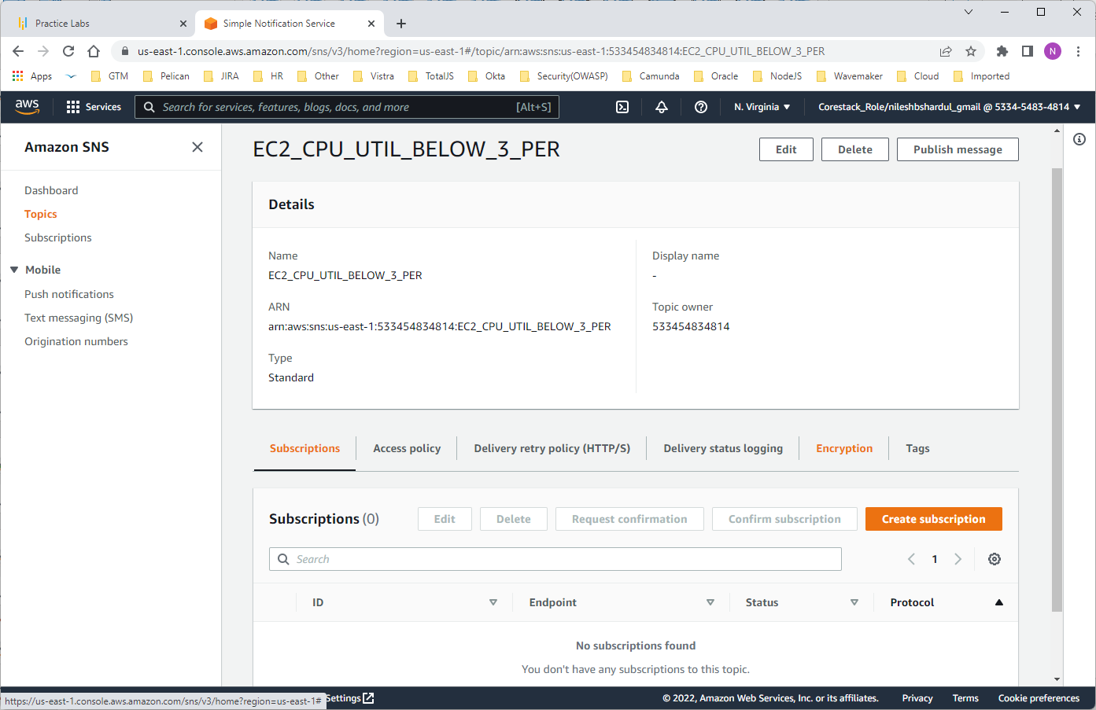
Step 8: Click on Create Subscription button

Slide 29
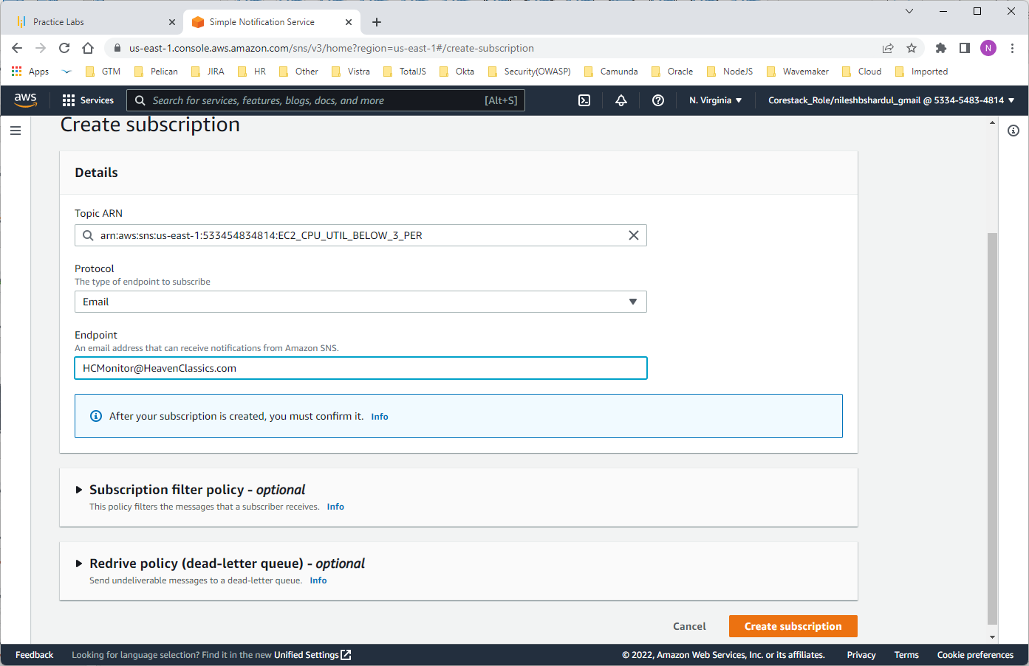
Step 9: Add email id - HCMonitor@HeavenClassics.com in the endpoint field

Slide 30
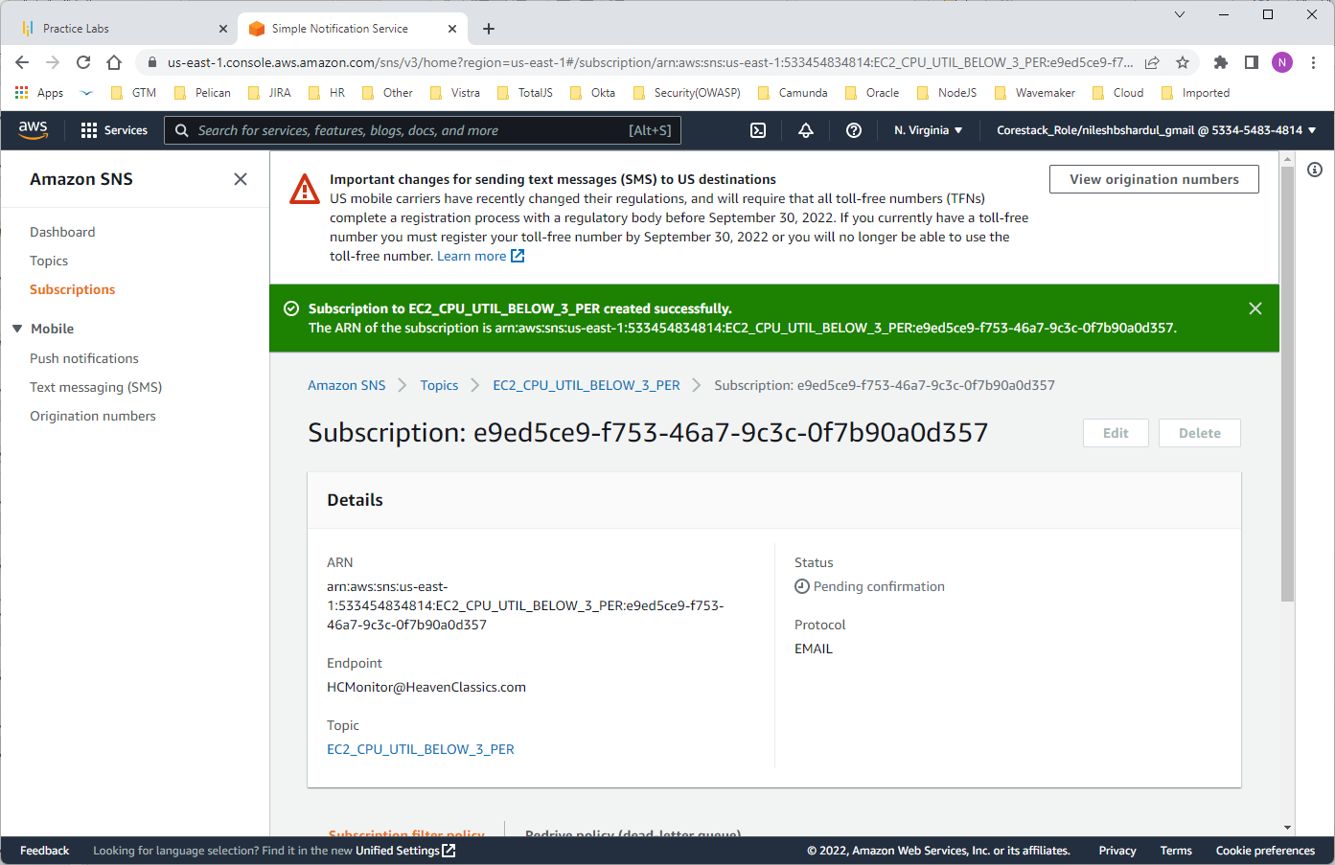
Step 10: Click on Create Subscription button. Status will be changed from Pending confirmation to Confirmed once the user accept the subscription after receiving the email.
Note : The step(confirming subscription) is necessary for the user to receive the emails set in alarm.

Slide 31
Objective 3 : Create an IAM group named Administrator Group and attach the full administrator access policy to the group
First create new user group in IAM and then attach AdministratorAccess policy to the group as per the given steps below

Slide 32
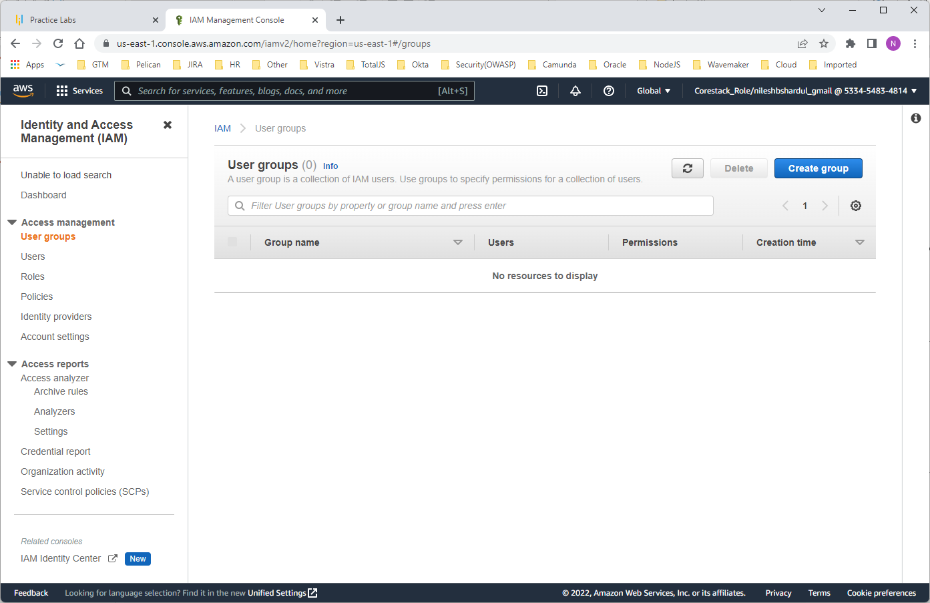
Step 1: Go to IAM > User groups

Slide 33
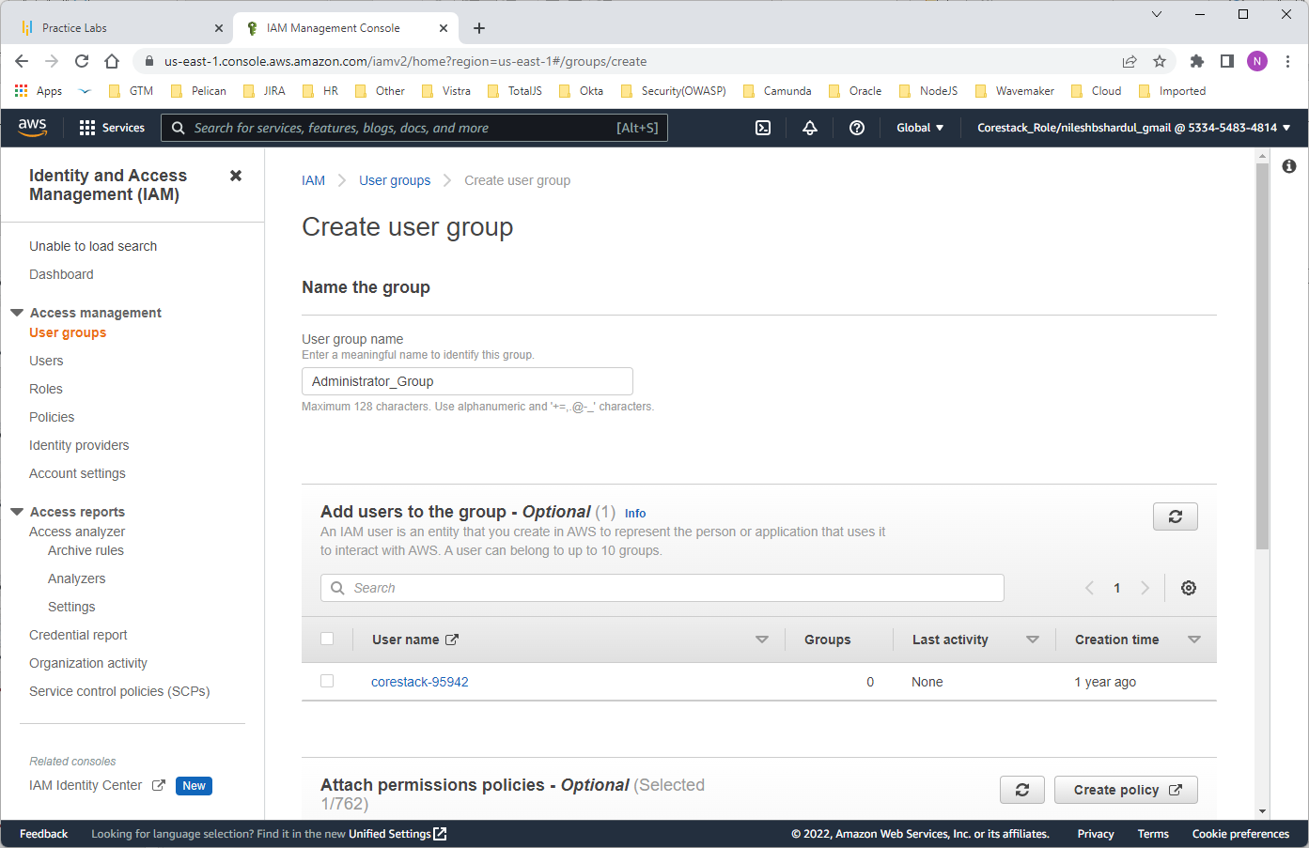
Step 2: Click on Create user group. Write group name e.g., Administrator_Group

Slide 34
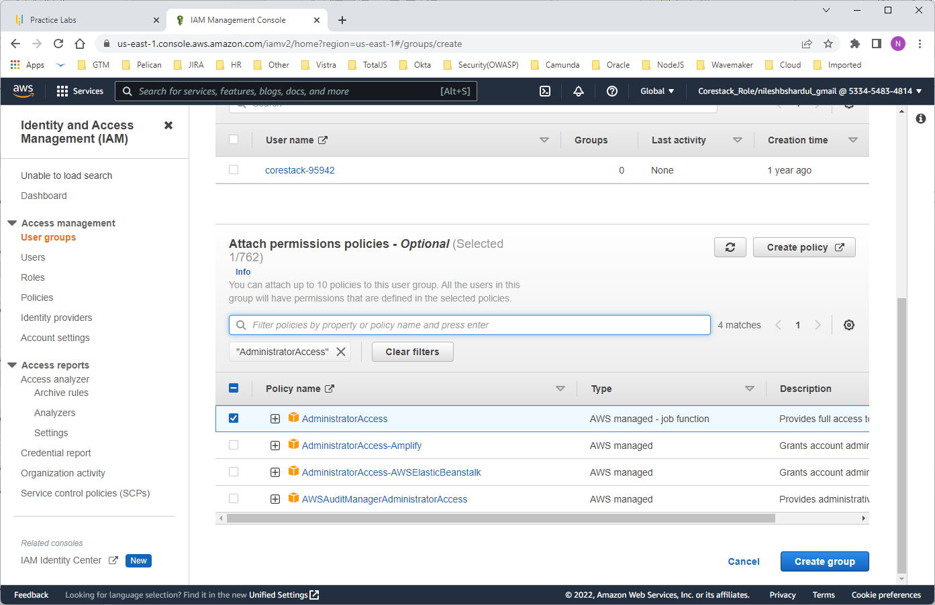
Step 3: Scroll below to Attach permissions policies and check on AdministratorAccess under Policy name

Slide 35
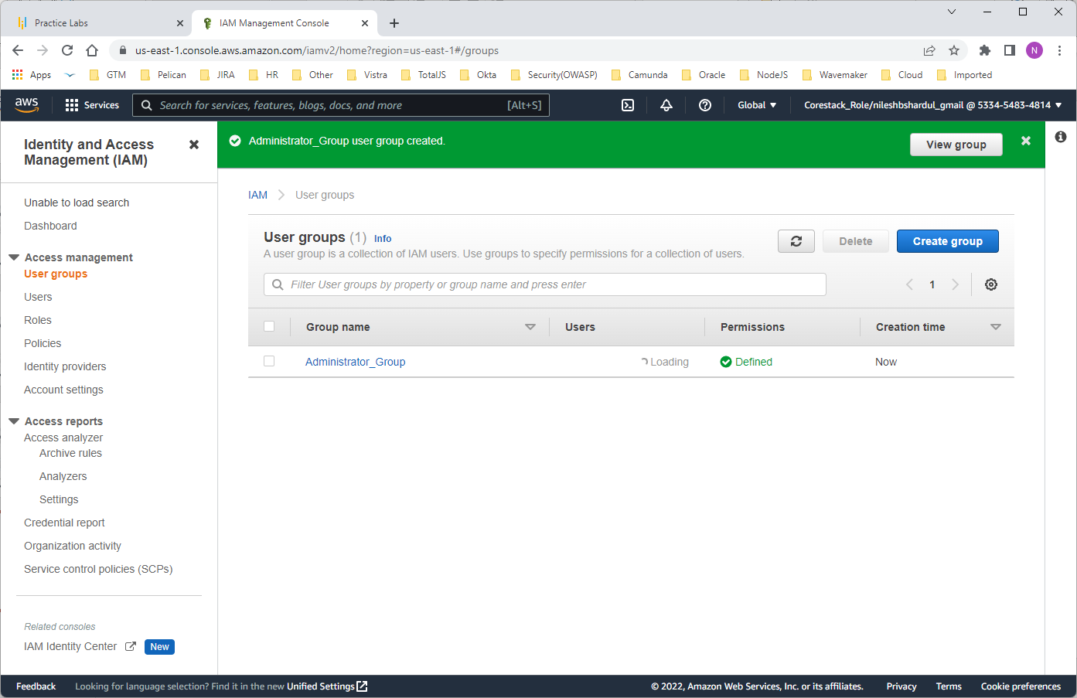
Step 4: Click on Create group button. The new group Administrator_Group will be created and listed as below

Slide 36
Objective 4 : Create a user for an employee of the company who requires administrator access to the company's AWS account, and then add the user to the Administrator Group.
First create new user in IAM and add the user in Administrator Group as per the given steps below

Slide 37
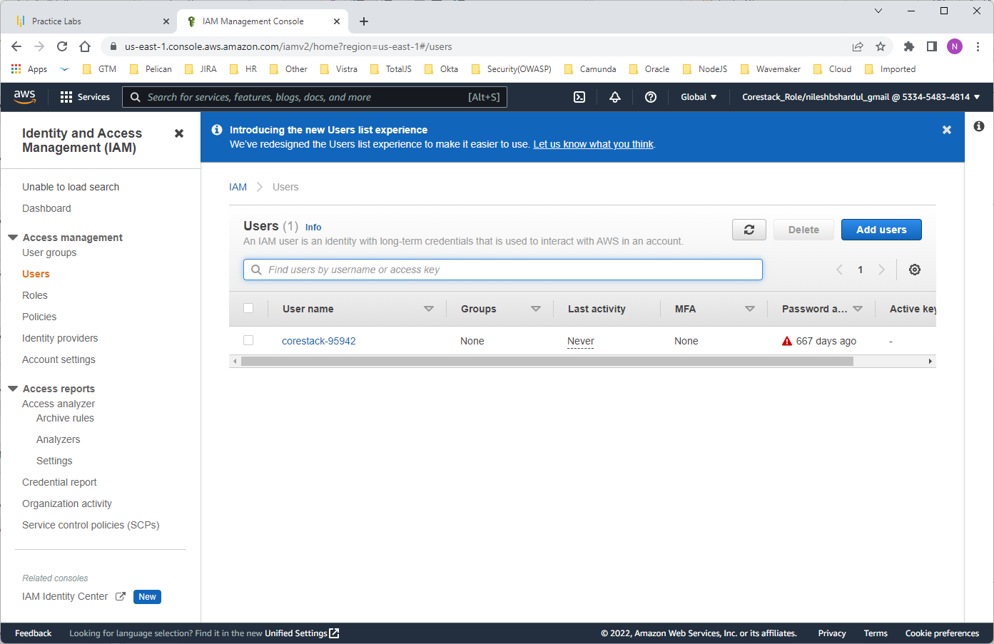
Step 1: Go to IAM > Users

Slide 38
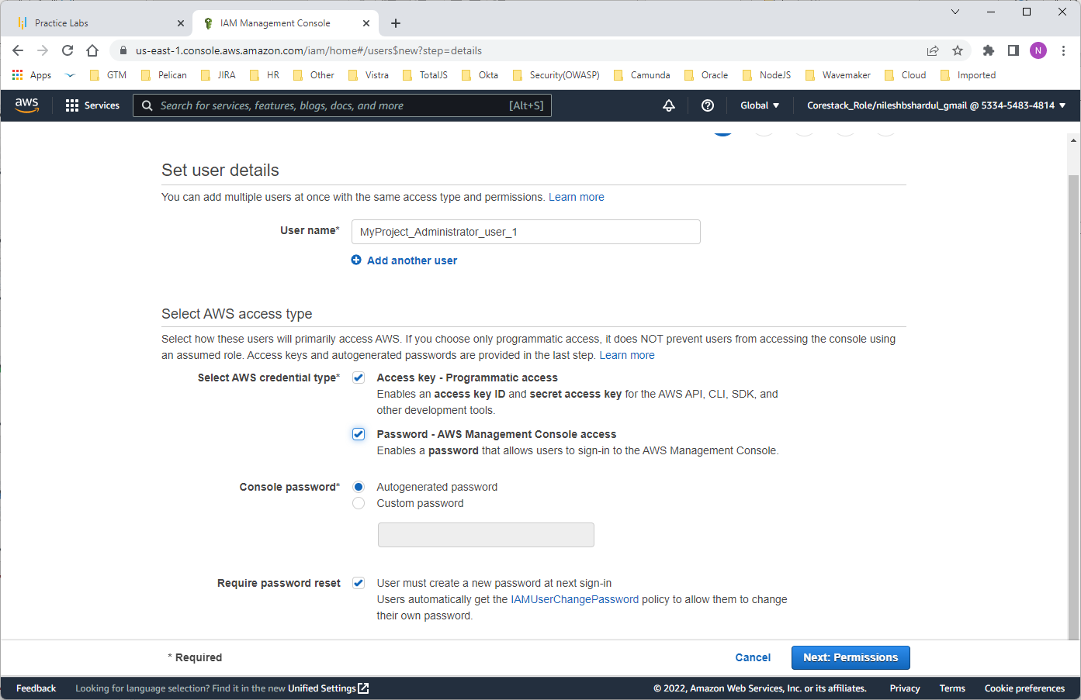
Step 2: Write username e.g., MyProject_Administrator_user_1 . As per requirement select -Programmatic access or Console access, password settings e.g., Autogenerate console password, allow user to create new password at first sign-in etc.

Slide 39
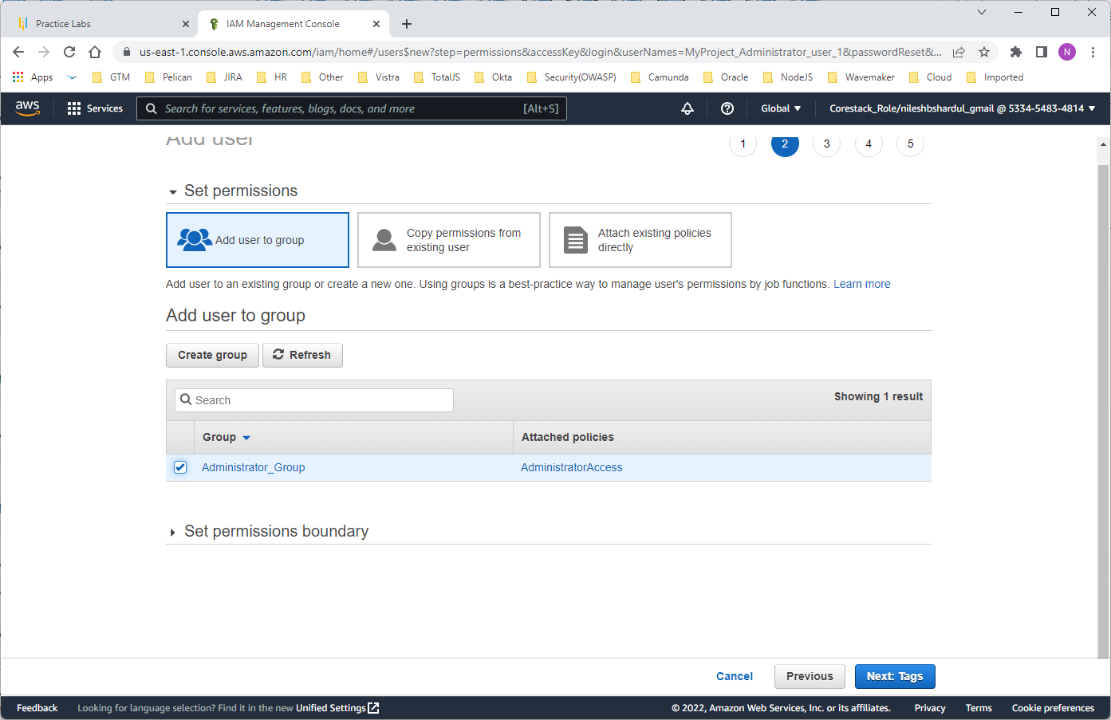
Step 3: Add user to Administator_Group created before

Slide 40
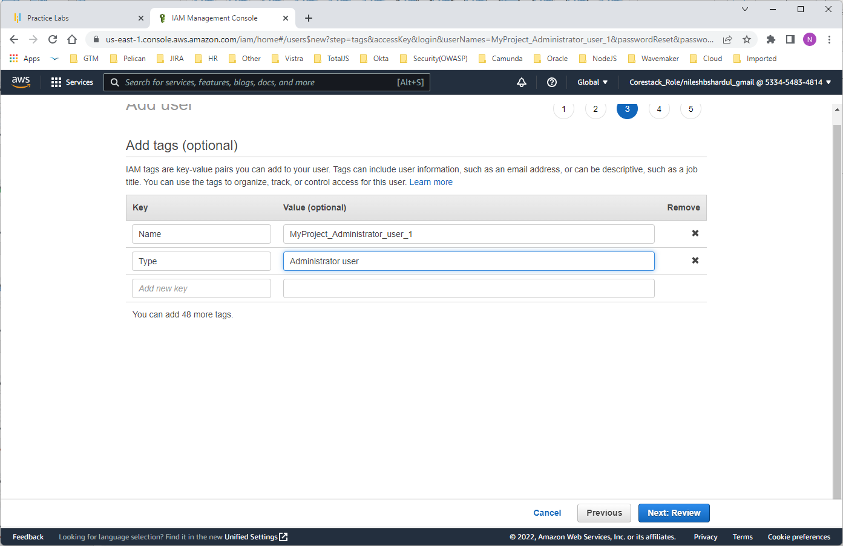
Step 4: You can add few more properties in tags such as user type

Slide 41
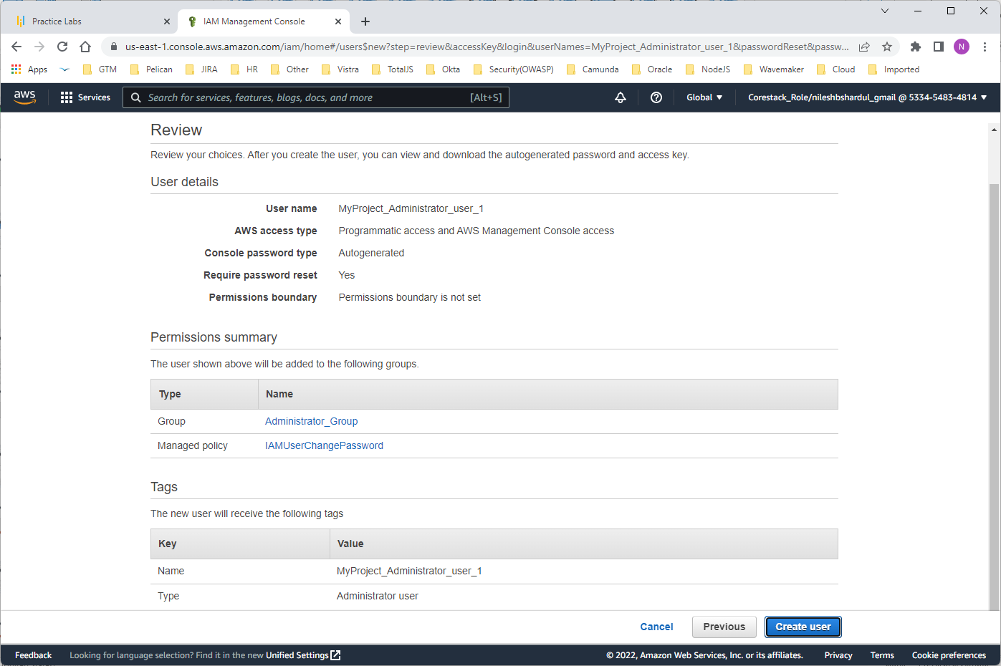
Step 5: Review the settings and click on Create user button to create new user

Slide 42
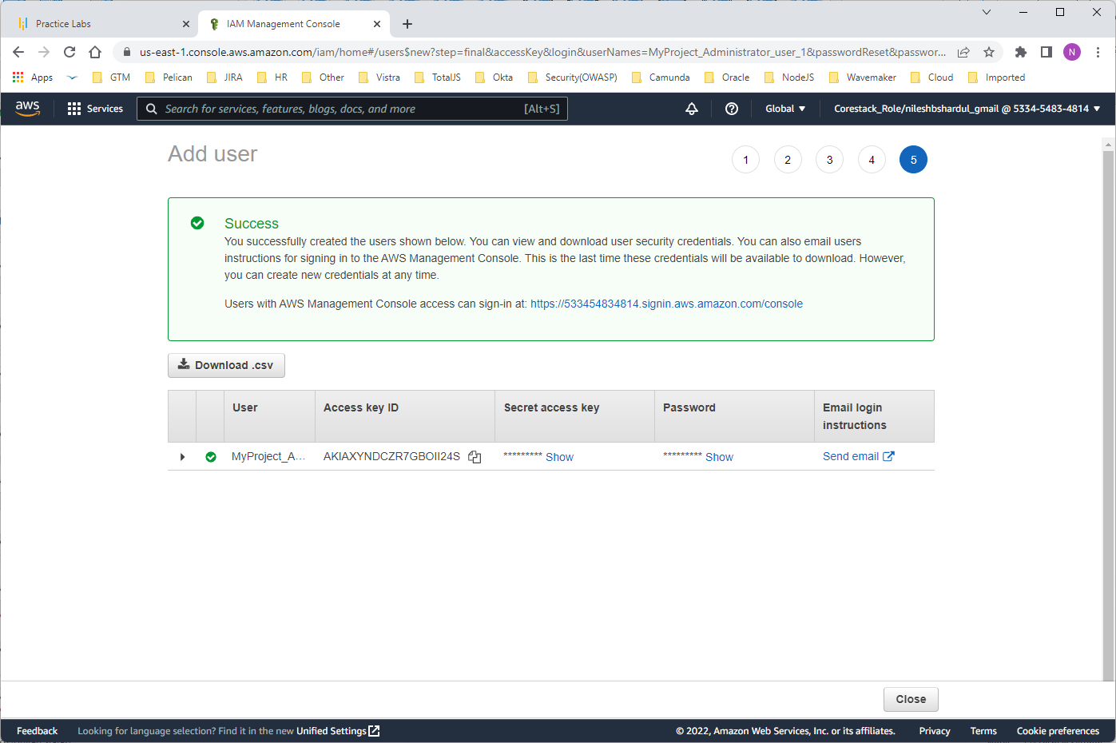
Step 6: You will see success message and summary of new user created

Slide 43
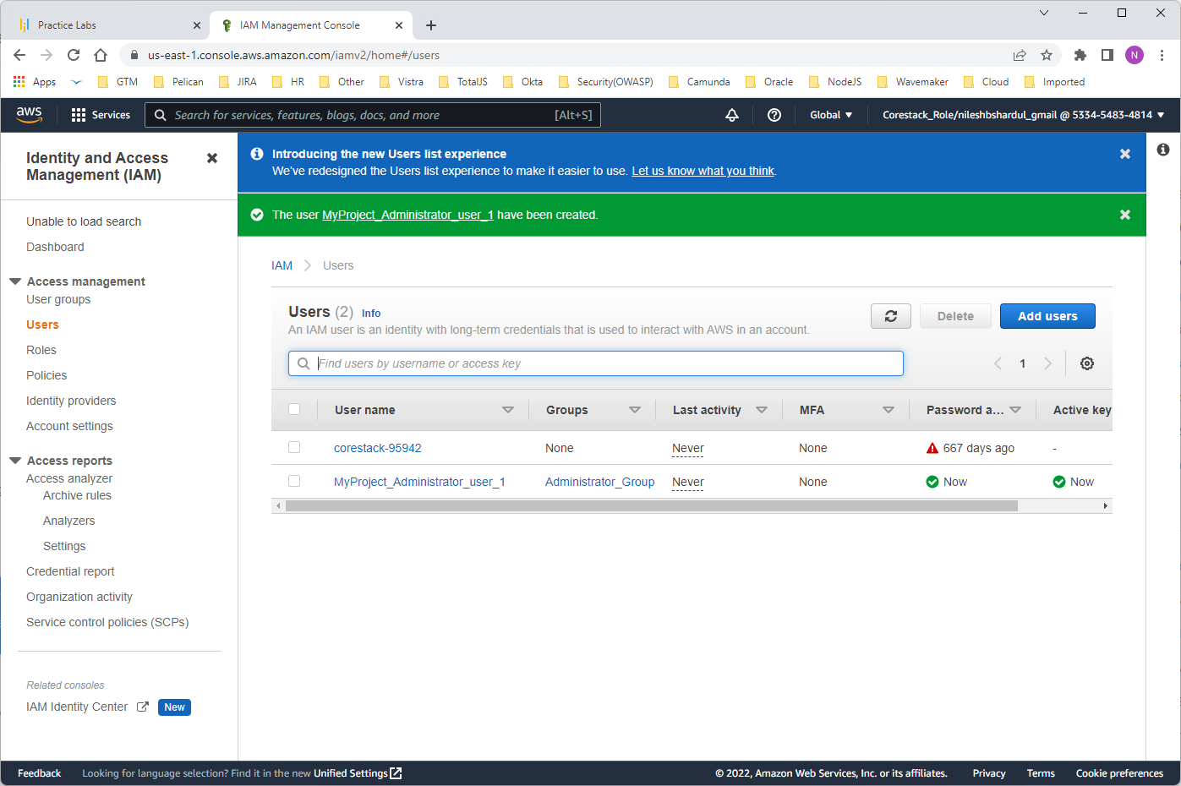
Step 7: New user can be seen under IAM > users

Slide 44
THANK YOU !!!

